Slide 1
CyberFlame

Slide 2
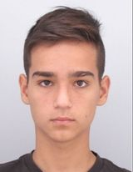
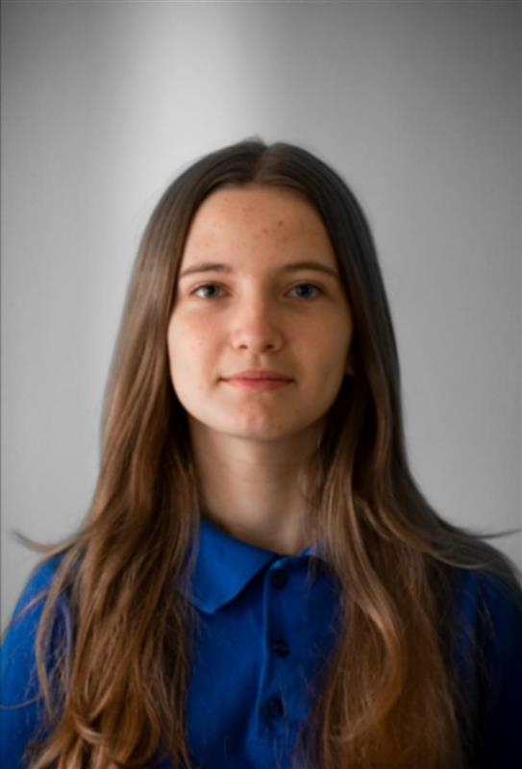
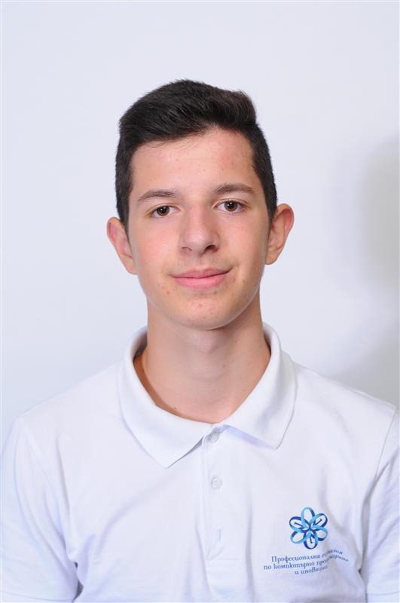
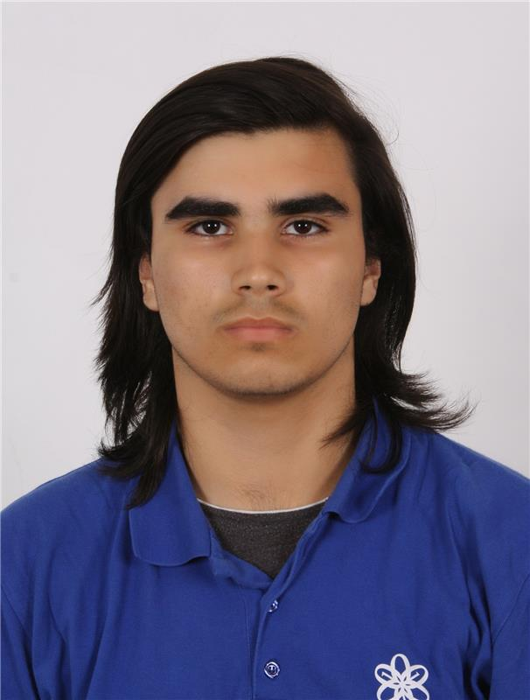
Our Team
Dimitar Grudov – Scrum Trainer
Polya Dimitrova - Designer
Petar Chapkanov – Back-end Developer
Daniel Georgiev – Front-end Developer

Slide 3



The idea of the site

Slide 4

Stages of realization
01
The imagining of the project
The start of the project
02
03
The late stage of the project
The last stage of the project
04

Slide 5











Things we used

Slide 6
Now let's continue with the site!

